Slide 1
Data Analysis Training with CLHLS: Introduction to Second-hand Data Analyses
Xian

Slide 2
0. Study Plan

Slide 3
Data Analysis Training
Goal: Helping you understand the general progression of data analysis in healthcare using the CLHLS dataset and techniques in STATA and R.
Lecturers:
Xian Zhang (xz152@dukekunshan.edu.cn), Research Fellow at the Global Health Research Center
Bruce Zhou (huiyuan.zhou@dukekunshan.edu.cn), Senior student majoring in data science
Ruolin Zhang (ruolin.zhang@dukekunshan.edu.cn) Senior student majoring in behavior science
Xiaochen Zhang (xiaochen.zhang@dukekunshan.edu.cn), Assistant Professor of Applied Economics at the Division of Social Sciences
Study Period: 9:00-10:00 a.m. every Friday, 4/9/2024-6/7/2024.

Slide 4
Scope of the Training
We will include:
Data cleaning
Data analyses project management
Association analyses.
Exploratory analyses
We will not include:
How to raise a research question?
Machine learning methods;
How to read literature; How to do a literature review?
Statistical details of any model or data analysis progress.

Slide 5
Syllabus
Lecture 1: Introduction to Second-hand Data Analyses: CLHLS (4/19/2024)
Lecture 2: Data Cleaning (4/26/2024)
Lecture 3: Project Management (5/10/2024)
Lecture 4: Data Analyses: Exploratory analyses (5/17/2024)
Lecture 5: Data Analyses (5/24/2024)
Lecture 6 and 7: Project Sharing (5/31/2024 & 6/7/2024)

Slide 6
1. Data Analysis Progress: Overview

Slide 7
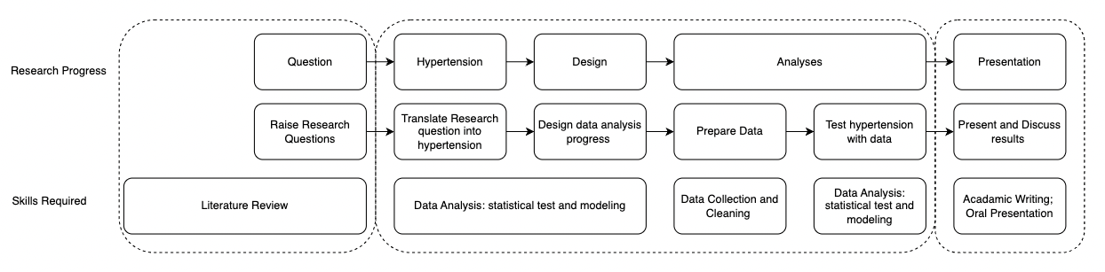
Flow of Research
Answer a valuable research question rigorously
Rigorously
Discover valuable questions
Scientific research
question
Make other believe your study is valuable

Slide 8
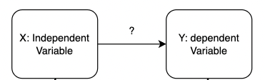
What do we care about in the Academic World?
Hypertension: Test what relationship of which independent variables on which dependent variables for which study population?

Slide 9
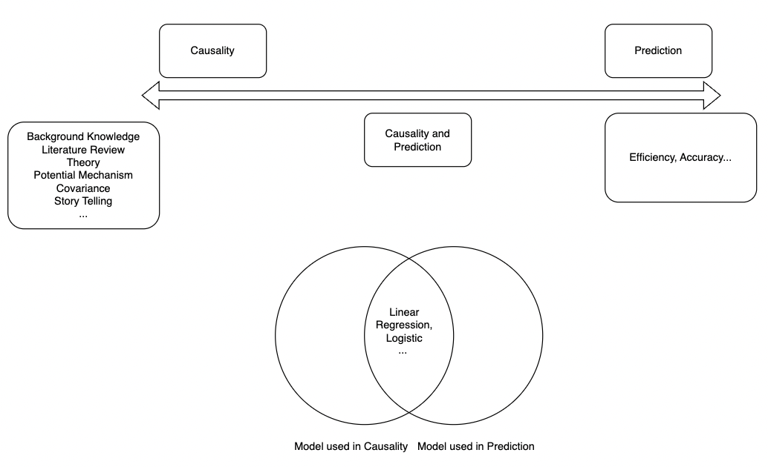
What do we care about in the Academic World?

Slide 10
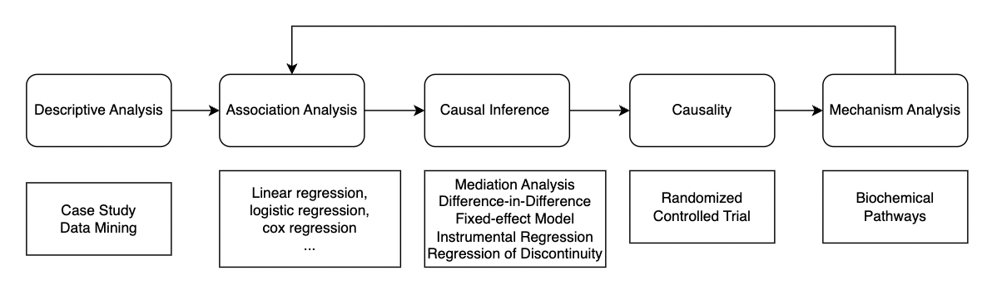
Causal pathway/Causal Chain in Health Study

Slide 11
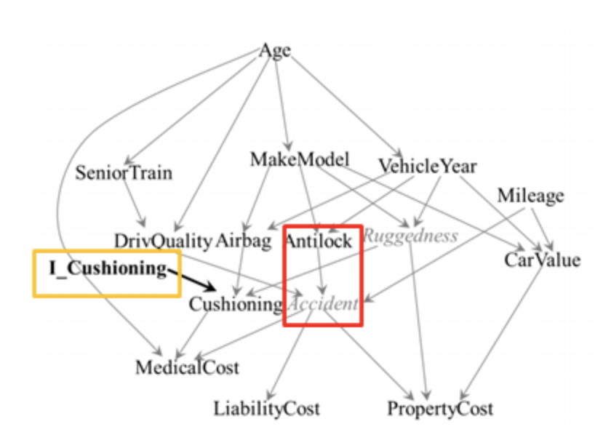
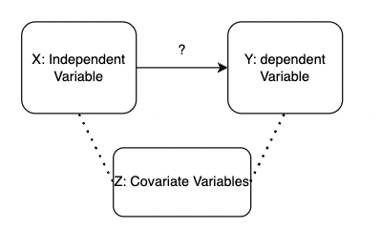
Causal web in Health Study: covariates --Variables Z

Slide 12
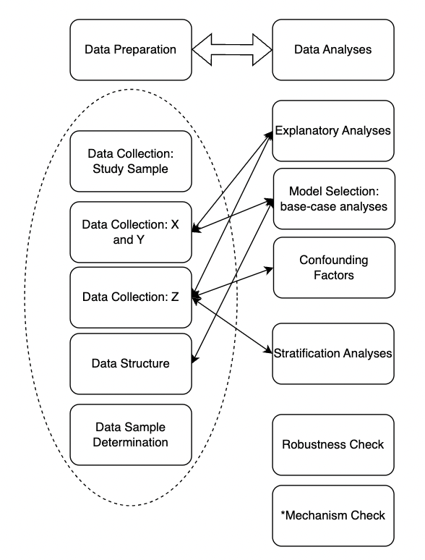
Research Design

Slide 13
Data Preparation
Where to collect variables X and Y with which study samples for your study population?
1. Open access survey data: CLHLS, CHARLS, CHNS…
2. What covariates to be included?
3. What data structure?
1. cross-sectional data
2. mixed cross-sectional data
3. Longitudinal/panel data
4. Determine study samples
1. combine all data collected
2. deal with missing values
3. *adjust data distribution
4. deal with outliers.

Slide 14
Data Analyses
Explanatory Analyses (let the data talk)
1. univariable: distribution
2. bi-variables: correlation of X and Y
3. ‘tri-variables’: correlation of X and Y by Z.
2. Model Selection and base-case analyses:
1. Feasible set: hypertension? Characteristic of X? Y?: e.g. logistic regression
2. Consider the data (structure) you have.
3. Adjust by data distribution of X and Y: e.g. Tobit regression
4. The First Regression (base-case): reg X on Y.
3. Confounding Factors (Z)：
1. Adding Z to base-case step by step.
4. Stratification Analyses (could be Z):
1. study at sub-sample (age group, sex …)
5. *Robustness Check:
1. cluster level of variance
2. measurement of X and Y.
…

Slide 15
2. Data Analysis Progress: Sample Paper

Slide 16
Paper Reading- Abstract
Summary Background Evidence from cohort studies in North America and Europe indicates that long-term exposure to fine particulate matter (PM2·5) is associated with an increased mortality risk. However, this association has rarely been quantified at higher ambient concentrations. We estimated the hazard ratio (HR) for all-cause mortality from long- term exposure to PM2·5 in a well established Chinese cohort of older adults.
Methods The Chinese Longitudinal Healthy Longevity Survey (CLHLS) is a prospective cohort study of men and
women aged 65 years and older enrolled in 2008 and followed up through 2014 for mortality events. We studied
individuals for whom residential locations were available in 2008 for linkage to 1 km grids of PM2·5 concentrations,
derived from satellite remote sensing. Cox proportional hazards models were used to estimate the effect of long-term
exposure to PM2 5 on all-cause mortality, controlling for age, sex, smoking status, drinking status, physical activity, ·
body-mass index, household income, marital status, and education. We then used our results to estimate premature mortality related to PM2·5 exposure in China's population aged 65 years and older in 2010.
Findings 13344 individuals in the CLHLS cohort had data for all timepoints, yielding follow-up data for
49 440 person-years. In a 3-year window, these individuals were exposed to a median PM2·5 concentration of 50∙7 μg/m3
(range 6∙7–113∙3). The overall HR for a 10 μg/m3 increase in this value was 1∙08 (95% CI 1∙06–1∙09). In stratified
analyses, HRs were higher in rural than in urban locations, in southern versus northern regions, and with exposure to
lower versus higher PM2 5 concentrations. Based on the overall HR, we estimated that 1 765 820 people aged 65 years ·
and older in China in 2010 had premature mortality related to PM2·5 exposure.
Interpretation Long-term exposure to PM2·5 is associated with an increased risk of all-cause mortality among adults aged 65 years and older in China, but the magnitude of the risk declines as the concentration of PM2 5 increases.

Slide 17
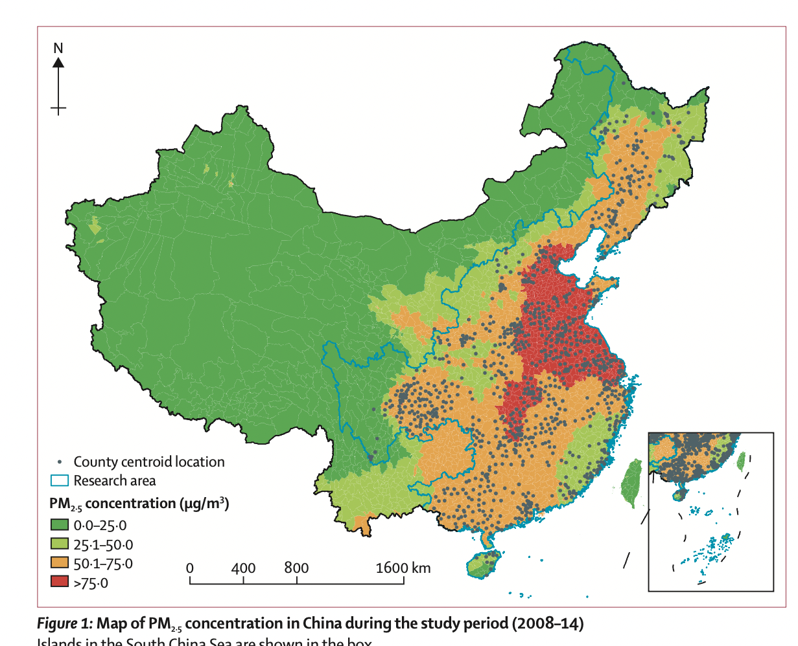
Paper Reading – Descript Independent Variable

Slide 18
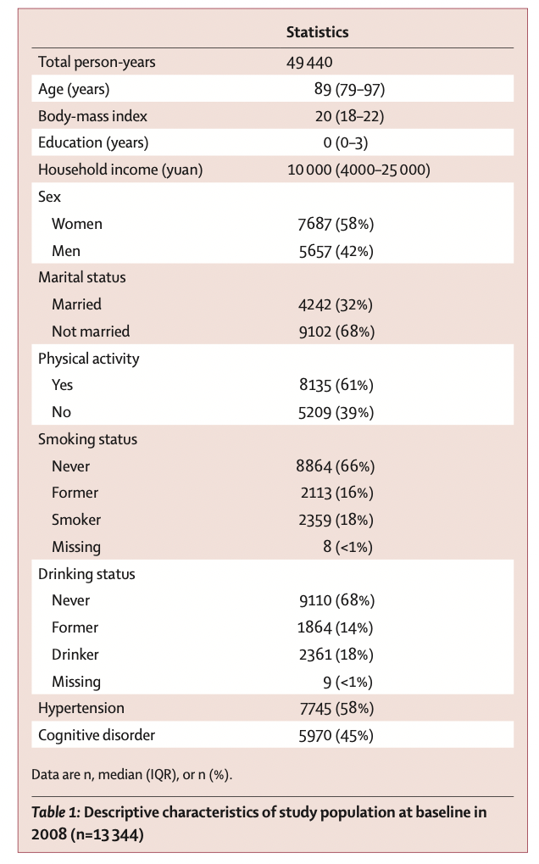
Paper Reading-Descript study sample and covariates

Slide 19
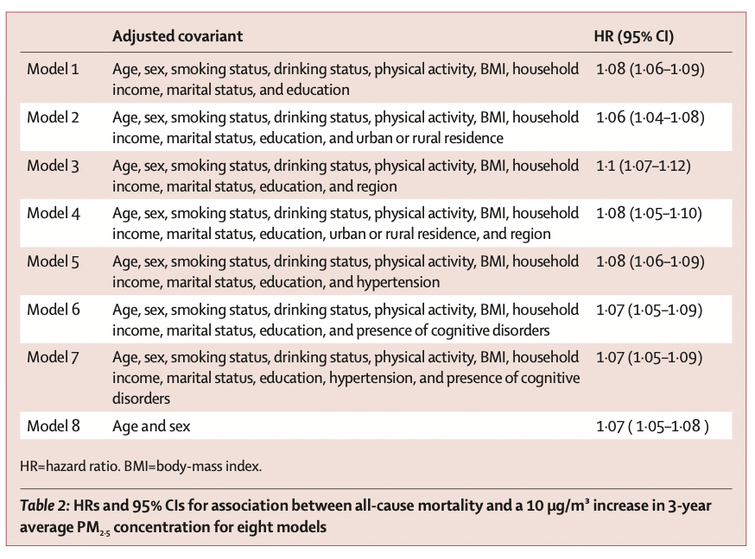
Paper Reading – Report association of X on Y by models

Slide 20
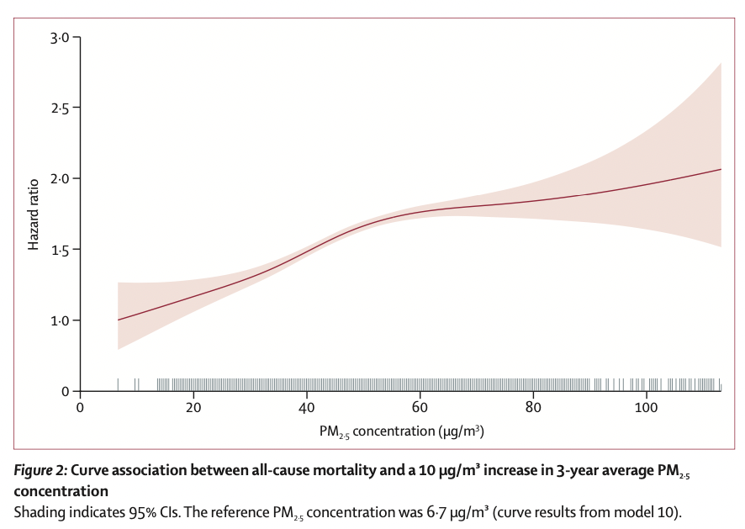
Paper Reading- ‘stratification’ of X on Y by X

Slide 21
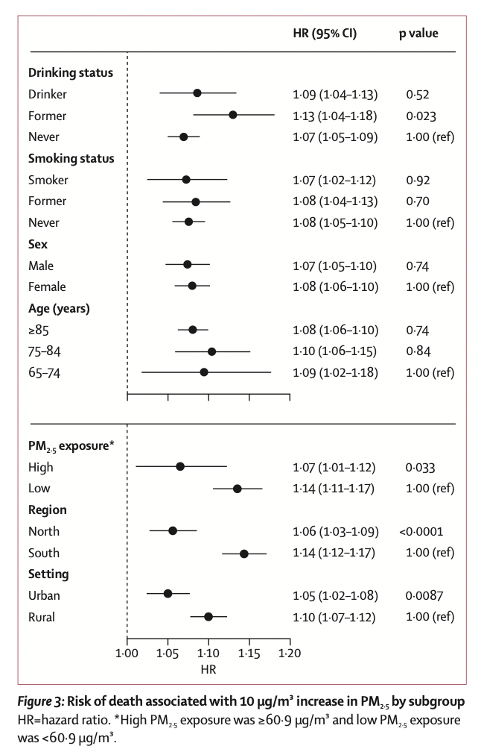
Paper Reading: Stratification Analyses of of X on Y by Z

Slide 22
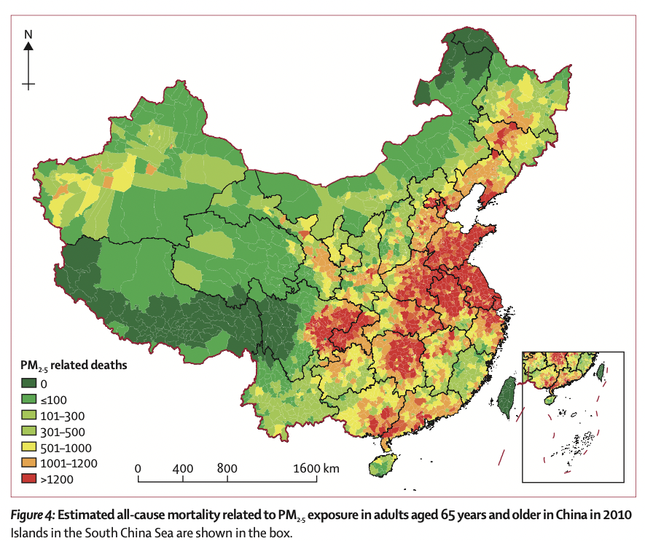
Paper Reading: Make other believe your study is valuable

Slide 23
3. CLHLS

Slide 24
3.1 Introduction of CLHLS : Sample

Slide 25
Chinese Longitudinal Healthy Longevity and Happy Family Study (CLHLS-HF) collected longitudinal data coordinated by the Center for Healthy Aging and Development Studies of National School of Development at Peking University. The first 8 waves of this survey study were conducted in 1998, 2000, 2002, 2005, 2008-2009, 2011-2012, 2014 and 2017-2018, in randomly selected about half of the counties and city districts in 23 Chinese provinces. In the 8 waves in 1998-2018, we have conducted face-to-face home-based 113 thousands interviews, including 19.5 thousands centenarians, 26.8 thousands nonagenarians, 29.7 thousands octogenarians, 25.5 thousands younger elders aged 65-79, and 11.3 thousands middle-age adults aged 35-64. The 9th wave is conducted in 2021 and extended as “The Chinese Longitudinal Healthy Longevity and Happy Family Study (CLHLS-HF), through: (1) Adding several family-relevant questions in addition to the initial questionnaire which contained about one-third of the total number of questions; (2) Extending from previously covering 23 to covering 27 (among 31) provinces, municipalities and autonomous regions in China. The 9th wave of CLHLS-HF will be completed in November 2021.
Website: https://opendata.pku.edu.cn/dataverse/CHADS;jsessionid=99062e80dc232017106347c41247

Slide 26
Objectives of CLHLS
General goal:
To shed new light on a better understanding of the determinants of healthy longevity of human beings.
Follow up the oldest-old and the comparison group of the younger people to ascertain changes in their health status, care needs and costs, and associated factors.
Collect intensive individual interview data including health, disability, demographic, family, socioeconomic, and behavioral risk factors for mortality and healthy longevity
Analyze the collected data to estimate the impacts of social, behavioral, environmental, and biological risk factors that are determinants of healthy longevity and mortality in the oldest-old.
Compare the findings with results from other studies of large populations at advanced age.
Specific goals

Slide 27
CLHLS Study Design
Covers 22 of China’s 31 provinces, which covers of 85% of the population
Randomly selected half of the counties and cities from
Baseline in 1998
7 follow-ups with replacement sample for deceased
2020 wave forthcoming and we have the priority to the access
1 more waves planned: 2023.
2020
2014
2018-2019
2011-2012
1998
2008-2009
2005
2000
2002

Slide 28
Sample Distribution by Vital Status
Total number of deaths 65+ = 26,701

Slide 29
Age Group Distribution
The CLHLS has the largest sample of centenarians in the world according to a report in Science.

Slide 30
3.2 Introduction of CLHLS : Data Structure

Slide 31
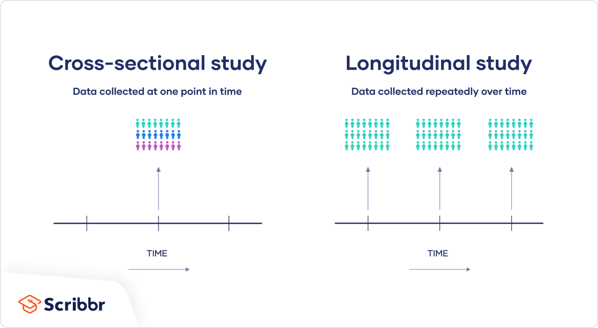
Data Structure: General
Mixed cross-sectional Study

Slide 32
Data Structure: CLHLS

Slide 33
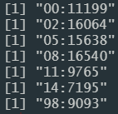
Different versions of datasets
Cross-sectional dataset: https://duke.app.box.com/folder/139686926006

Slide 34
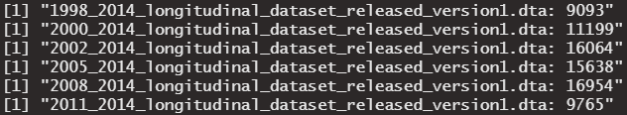
Different versions of datasets
Longitudinal original dataset: https://duke.app.box.com/folder/139685198413
https://duke.app.box.com/folder/139686556229

Slide 35
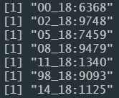
Different versions of datasets
Longitudinal recoded dataset with survival time:
https://duke.app.box.com/folder/139686071322

Slide 36
3.3 Introduction of CLHLS : X, Y, and Z.

Slide 37
Survey Data
Main Survey
(180 items)
ADL and IADL
Physical
Performance
Cognitive Functions (MMSE)
Demographic
Self-reported Health
Socio-economic
Lifestyles

Slide 38
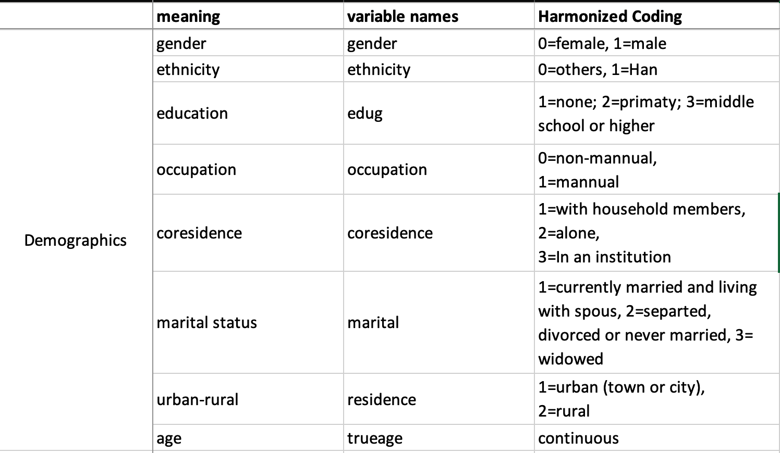
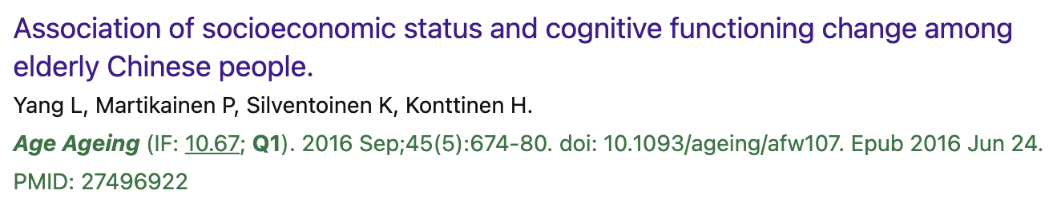
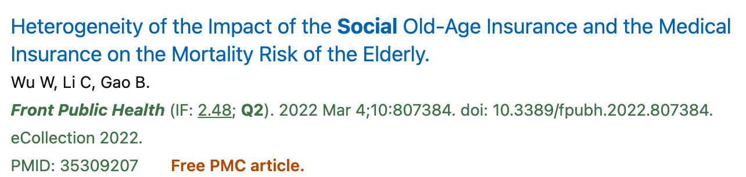
Demographic & Socialeconomic Background

Slide 39
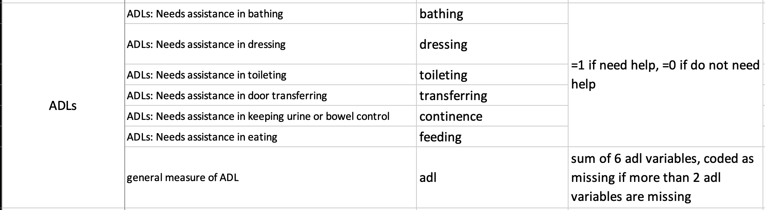
Activities of Daily Living (ADL)

Slide 40
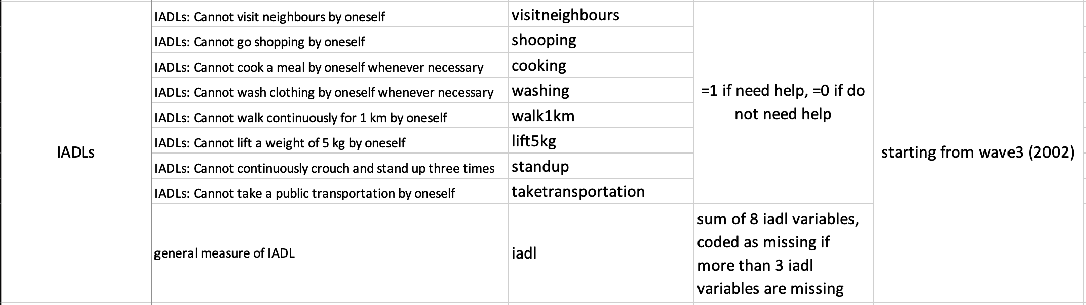
Instrumental Activities of Daily Living (IADL)

Slide 41
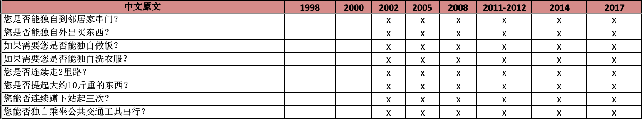
Instrumental Activities of Daily Living (IADL)

Slide 42
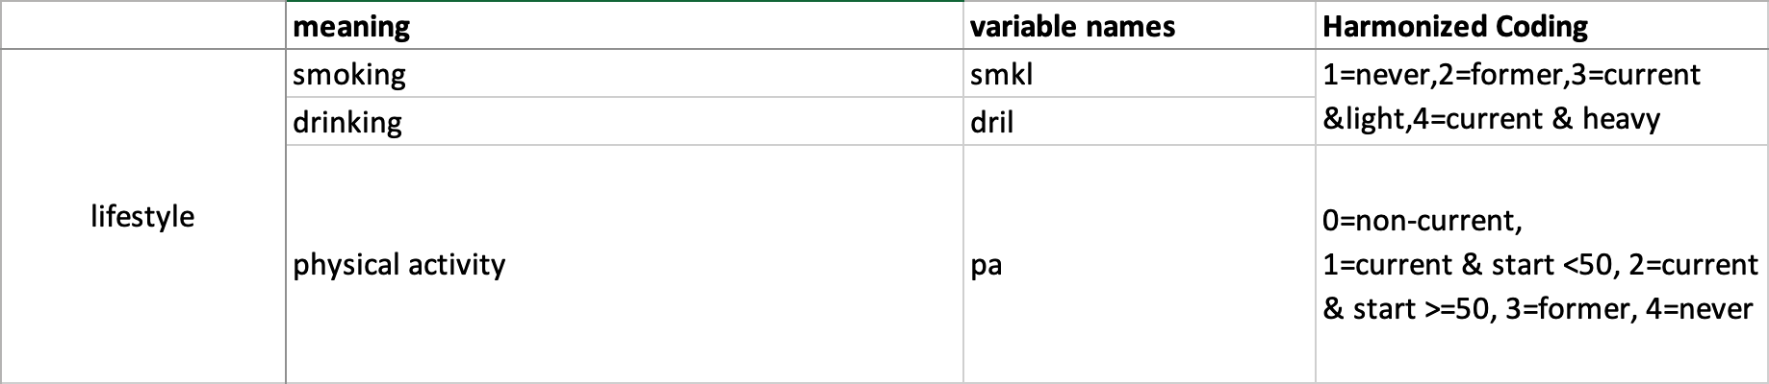
Lifestyles—smoking, drinking & physical activity

Slide 43
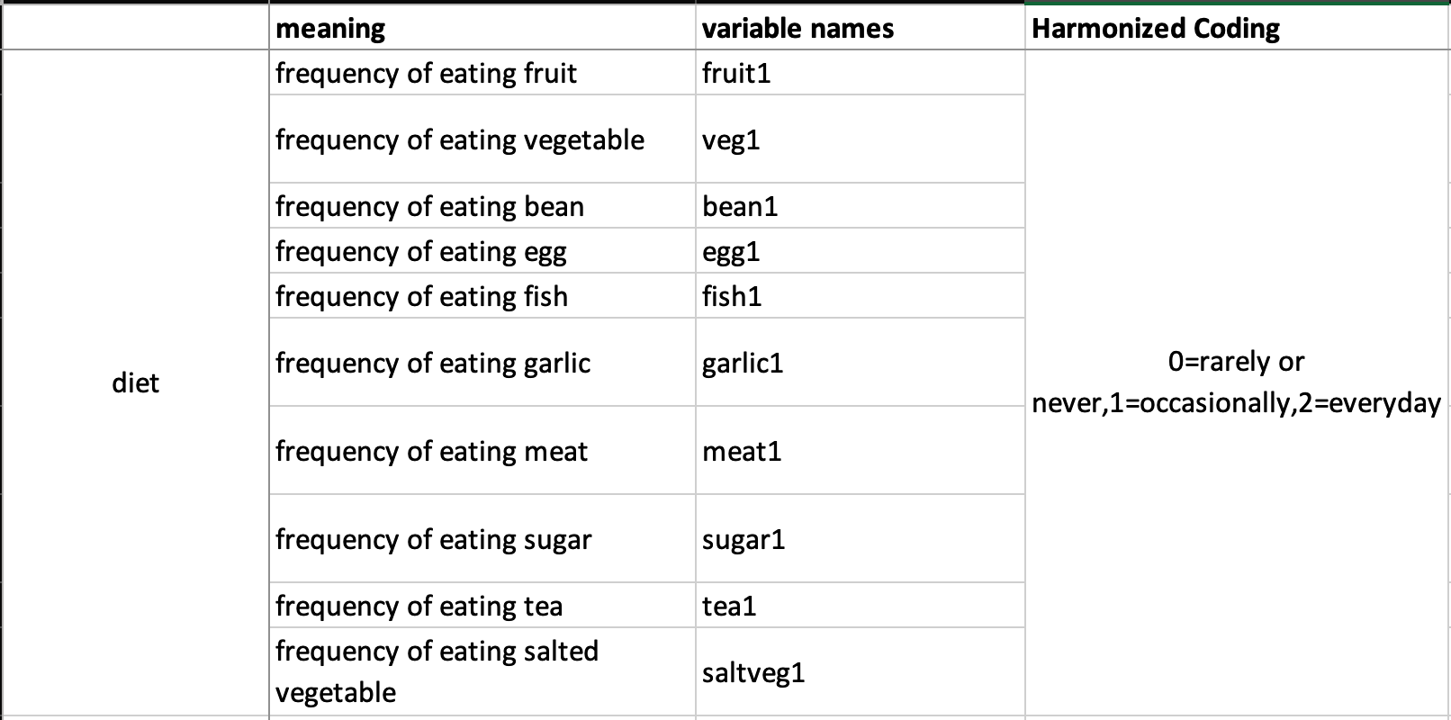
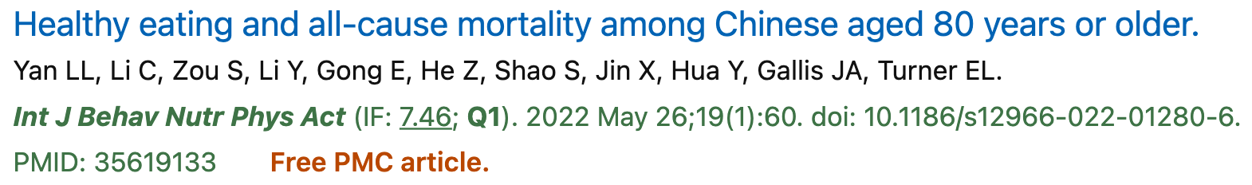
Lifestyle-Diet
Project done by Siyu located in P02 SHE-index and all-cause mortality-Prof Yan

Slide 44
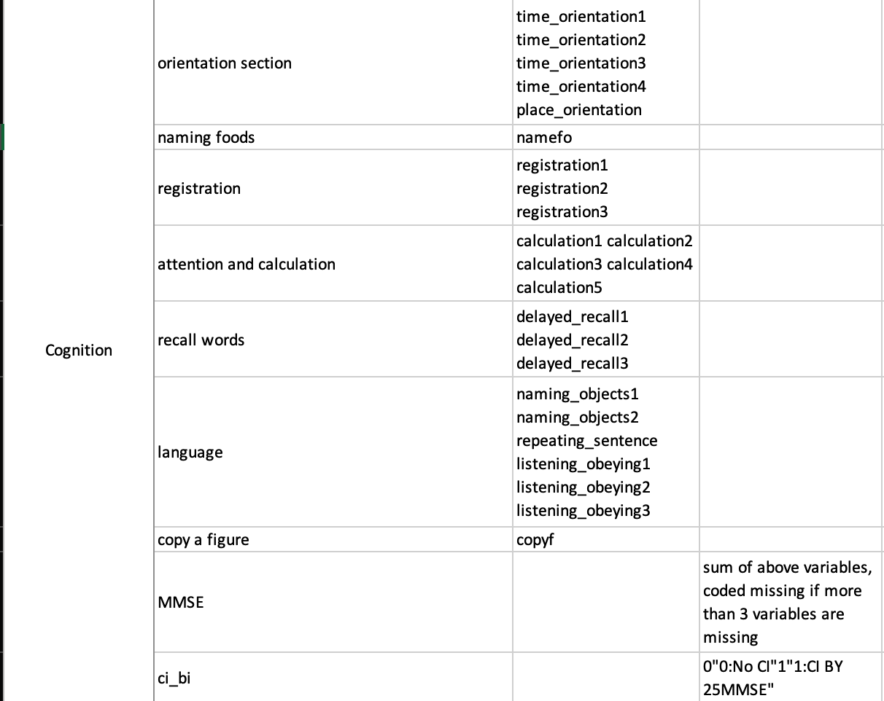
Cognitive Functions (MMSE)

Slide 45
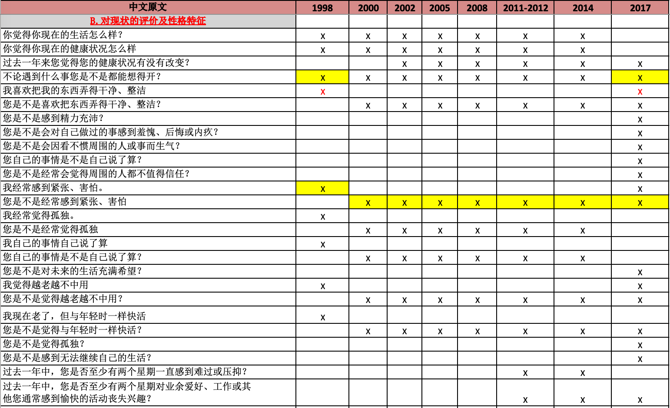
Mental Health– not standard CESD-8 until 2017/8

Slide 46
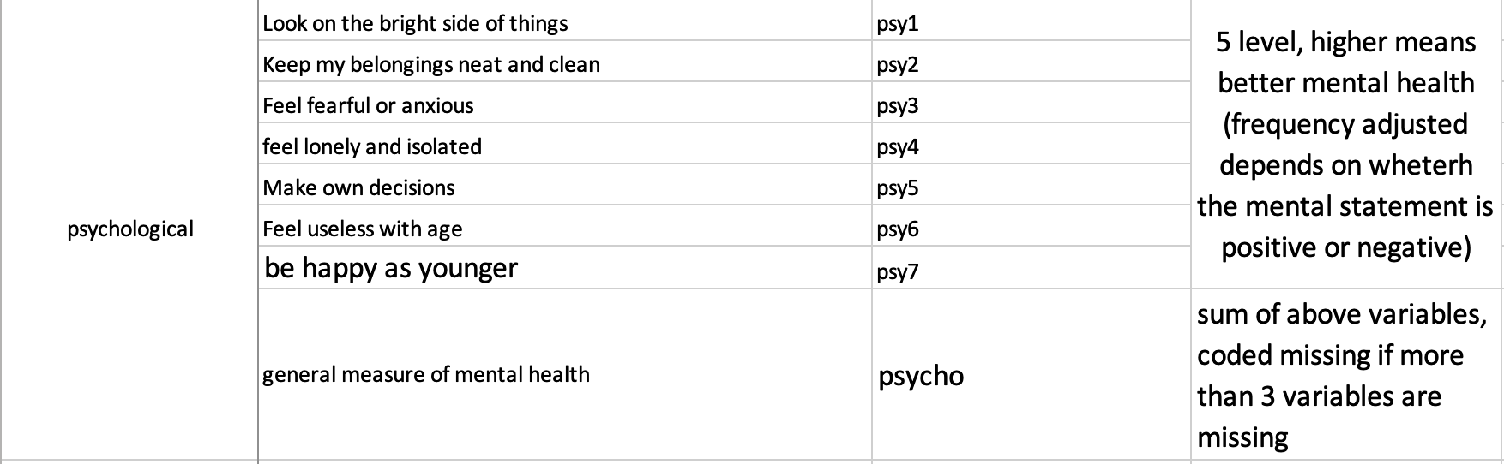
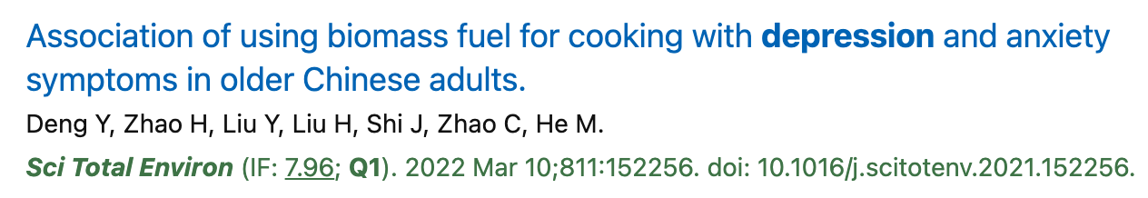
Mental Health

Slide 47
Disease by self-recall
Disease-2014 | 疾病-2014
hypertension | 高血压
diabetes | 糖尿病
heart disease | 心脏病
stroke or cvd | 中风或心脑血管疾病
bronchitis, emphysema, pneumonia, asthma | 支气管炎、肺气肿、肺炎、哮喘
tuberculosis | 结核病
cataract | 白内障
glaucoma | 青光眼
cancer | 癌症
prostate tumor | 前列腺肿瘤
hyperplasia of prostate gland | 前列腺增生
gastric or duodenal ulcer | 胃或十二指肠溃疡
parkinson's disease | 帕金森氏病
bedsore | 褥疮
arthritis | 关节炎
rheumatism or rheumatoid disease | 风湿病或类风湿性疾病
dementia | 痴呆症
epilepsy | 癫痫
cholecystitis, cholelith disease | 胆囊炎、胆石症
blood disease | 血液病
chronic nephritis | 慢性肾炎
galactophore disease | 半乳头病
uterine tumor | 子宫肿瘤
hepatitis | 肝炎

Slide 48
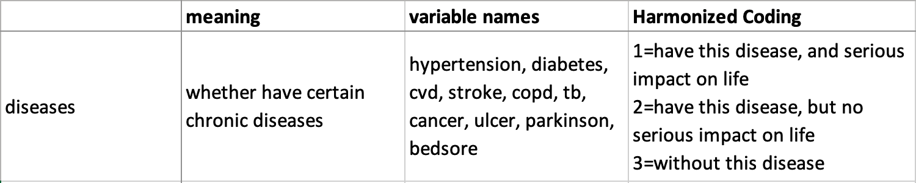
Disease by self-recall

Slide 49
Biomarker Data
The 2008 health and biomarker survey contains 2,035 respondents (1,486 aged≥65 and 549 aged 40-59).
Biomarker information includes
Examination of lungs and respiratory tract, breasts, extremities, spine, lymph and thyroid, liver, spleen and kidney;
Routine blood test (wbc, rbc, hgb, hct, mcv, mch, mchc, plt);
High and low-density lipoprotein;
Creatinine;
MDA (malondialdehyde level);
SOD (superoxide dismutase activities);
Glucose.

Slide 50
Genetic Data
In 1998, 985 respondents aged ≥80 from CLHLS survey were genotyped with FOXO1A, FOXO3A and ABRB2 genes information.
In 2008 and 2011, genetic information (GWAS) from 3,248 individuals were detected.
2,043 cases aged ≥65 were from CLHLS survey
1,205 cases aged 40-59 were neighboring controls of the CLHLS centenarians interviewees in 2008.
Ongoing effort to genotype all participants with blood samples

Slide 51
Data Utilization and Publication
Utilization for main dataset
1998-2018 survey data open to the public.
All users need to sign the data usage agreement(DUA) for the access to main dataset (contact Kehan if you haven’t signed DUA after this meeting).
http://centerforaging.duke.edu/data-downloads
Utilization for Genetic Data
On Server
Publications by March 2020
17 peer-reviewed books
356 peer-reviewed papers in English on SCI and SSCI journals
455 peer-reviewed papers in Chinese
35 Ph.D dissertations and 104 Master theses
>58 policy reports to various governmental agencies

Slide 52
Q & A

